Slide 1
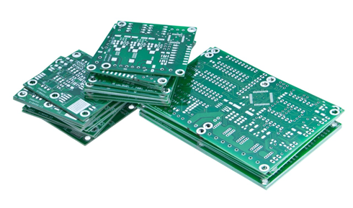
Project Based Learning
Holistic Development :Outcome Based Education
for A. Y.2021-22
Final presentation DATE: 06/10/2021
Group No: 13
Member 1: HET DANI (23)
Member 2: SIDDHANT KADAM (46)
Member 3: ISHA ROSHAN (52)

Slide 2
Contents
Title of the Project
TV 2035 track (Problem Identification) (Need of the project in Society )
Technical Solution (your solution in the form of your Project )
Abstract (Description of your Project)
Proposed Methodology/ Algorithm
Future Lens: To understand the future opportunities and challenges (Future Scope)
User Lens : Identification the key people/points , group and organization that have direct influence of your project.
Organizational lense: Why TV 2035 based Projects ?
Outcome

Slide 3
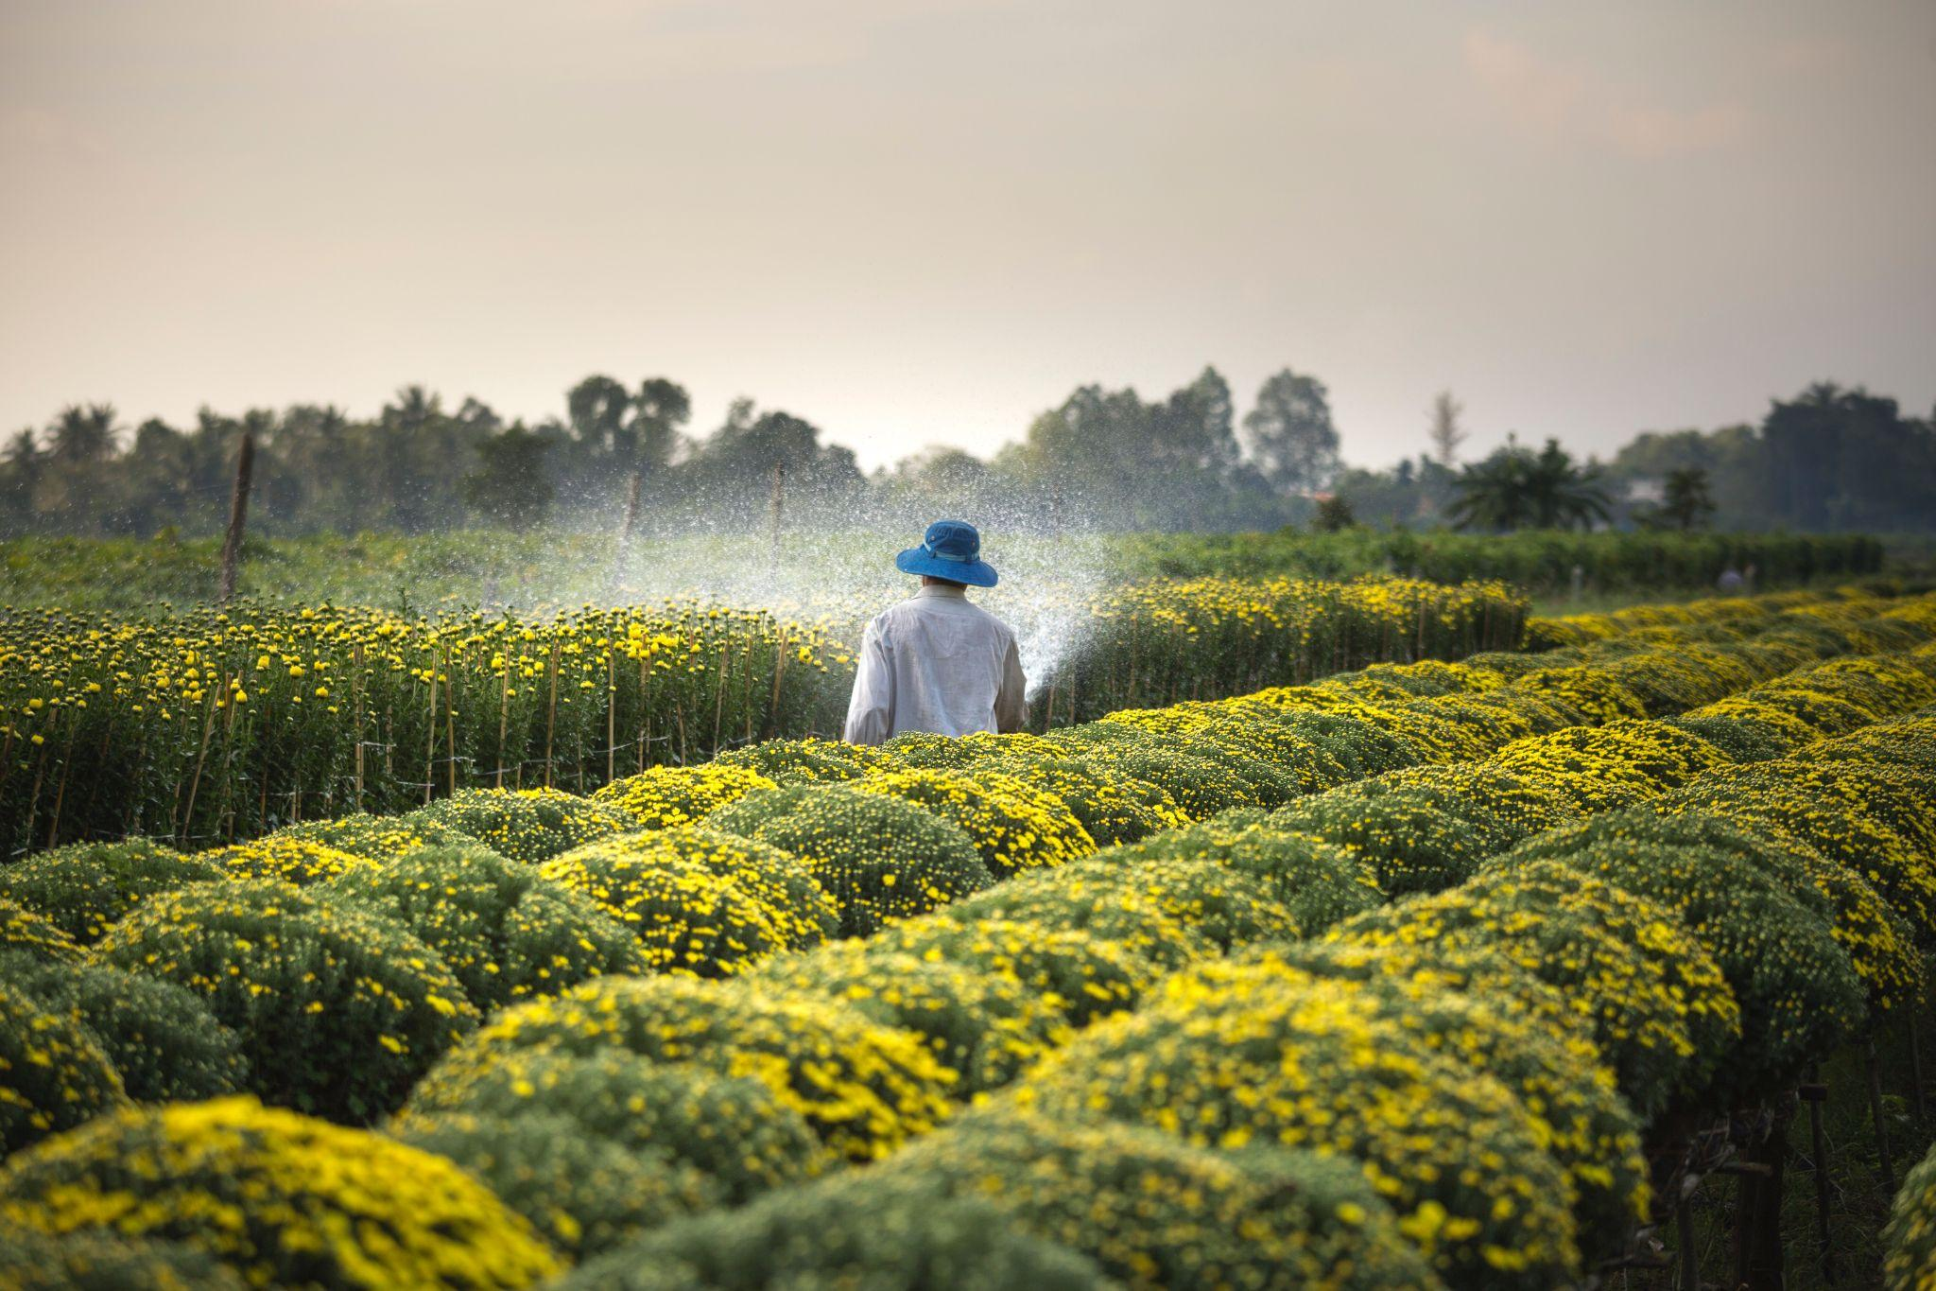
Title of the Project-Problem Statement –GA6 (5mks)
TITLE OF THE PROJECT:
SMART IRRIGATION SYSTEM
Under the Guidance -
Mrs. Aradhana Manekar
Group 13 (23, 46, 52)

Slide 4
Problem Identification :TV 2035 track and its importance GA1 (5mks)
The energy source massively used for water pumping in irrigation purposes is based on fossil fuels (diesel oil). Despite the water availability and fertile, farmers struggle with the high cost of fuels used in the pumping systems.
The fossil fuels due to its high demand in agriculture, are sooner or later going to get exhaust for which we would need to rely on renewable sources of energy like water, wind, solar etc.
Under conventional irrigation system, irrigated land is either under irrigated or over irrigated resulting in adverse effects on crop growth and wastage of water. Through the proposed Smart Irrigation System project, we would be saving huge amount of water and there would no chance of over or under irrigation due to the automatic checking of soil moisture level based on temperature level and the use of fossil fuels is also eliminated.

Slide 5
Technical Solution-GA2 (5mks) (your solution in the form of your Project )
The irrigation process begins only when the certain level of moisture begins thereby reducing chances of over or under irrigation
The proposed irrigation system is efficient in managing water based upon soil moisture, environmental temperature and humidity.
2
4
1
3
5
An automatic irrigation system to save water from getting wasted due to automatic checking of soil moisture.
This automated system minimizes farmers intervention in farming, increases crop production, saves time, helps remote monitoring and controlling and easy to install.
The system would work without the need of farmers intervention which would be of great help to them.

Slide 6
Abstract (Description of your Project) (5mks)
Overall with the huge water requirements in the irrigation process, there is a need for a smart irrigation system that could be able to save 60-70% of water. This prototype mainly aims to save time and avoid problems or human errors. Also it will help to save conserve water as mentioned earlier by automatically providing water to the plants depending on their temperature levels.
It can prove to be efficient in agricultural fields and with technology advancement in microcontroller systems there is always a chance to reduce risks and make work simpler and to provide solution for problems. The application of this system is to control the water system by using a arduino microcontroller and a temperature level sensor to check the temperature level and supply water as and when the temperature level is high and moisture is low in the soil.

Slide 7
Application of your project -GA3 (5mks)
In this system, soil temperature sensor senses the temperature level of the soil. If soil gets dry then sensor senses high temperature level and automatically switches on the motor and water pump supplies water. As plants get sufficient water and soil gets wet then sensor senses enough moisture in soil after which the motor will automatically stop. But in this design we use temperature sensor to replace it to the soil moisture sensor.
If the temperature of the soil is above 45 degrees then a LED Light situated in the circuit will glow to highlight the working and will respectively stop when the temperature of soil is attained below 45 degrees.

Slide 8
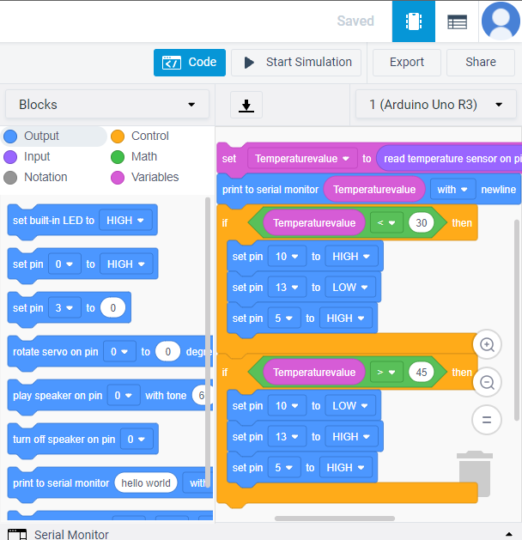
Application of your project -GA3 (5mks)
Code :

Slide 9
Proposed Methodology/ Algorithm-GA4 (5mks)
The outmoded irrigation technique has been replaced with automated technique. Many smart irrigation systems have been devised. A smart irrigation system, contrary to a traditional irrigation method, regulates supplied water according to the needs of the fields and crops. The feedback mechanism of a smart irrigation system is a temperature sensor.
Temperature sensor is placed at a specific location and based on its value the water is being pumped to corresponding area up to a predetermined time. Wireless communication technology will make the communication possible between transmitter section and receiver section. This will avoid the presence of many wires in the field. Otherwise it may create a lot of problems to ploughing, harvesting, etc

Slide 10
Development Experience –GA7 (5mks)
The development of the proposed system gave us a valuable experience in creating projects on software like Tinkercad which provided us a very user-friendly platform for building circuits.
While creating the system we ensured that the system should be effective in conserving the water and provide a smart solution to modern problems.Initially we carried out great research and went through several papers published on the topic of Smart Irrigation System and came across different constraints and the various methods through which the system could be implemented and finally with little modifications and our own idea we came up with a simple and effective system that mainly follows the following steps:
The checking of soil moisture level using temperature sensor and verifying whether level is above or below 45. When level goes above 45 the DC motor begins to work and LED starts glowing indicating the start of irrigation process to the farmer. If the level is below 45 the DC motor does not work and the LED also doesn't glow.

Slide 11
Identify the Learning issue faced by your team-GA8 (5mks)
Issues faced by our team at the start of the project was that we had picked up our topics and thought were familiar with the topic but later after research on our topic we were a bit in confusion on how to exactly implement our idea. The main issues was to find a suitable platform to get started with our idea of project. We went through different platforms for example, Proteus, Arduino, Tinkercad. First we thought we would be able to implement our idea on Proteus and started with it, but unfortunately were not able to implement as a whole.
During that period there were many errors and mistakes in the building of the circuit which at the start we weren’t able to understand, but after researching about the error we were able to understand the error and fix it. Later due to shortcomings on Proteus, we decided to implement our idea on Tinkercad and on that platform too we were welcomed by errors in the circuit and code but were able to overcome it with the help of research and determination.

Slide 12
User Lens : Identification the key people/points , group and organization that have direct influence of your project : Build the team and team efforts –GA9 (5mks)
To apply the system for improvement of health of the soil and the plants.
To cut overall cost and maintenance of the farmer and just a one time installation.
A formula of Lower consumption = Lower Cost + Environmental Responsibility.
Studies and Irrigation Association have shown that smart irrigation system are able to save between 20% to 50% of water hence, more water conservation and lower wastage.

Slide 13
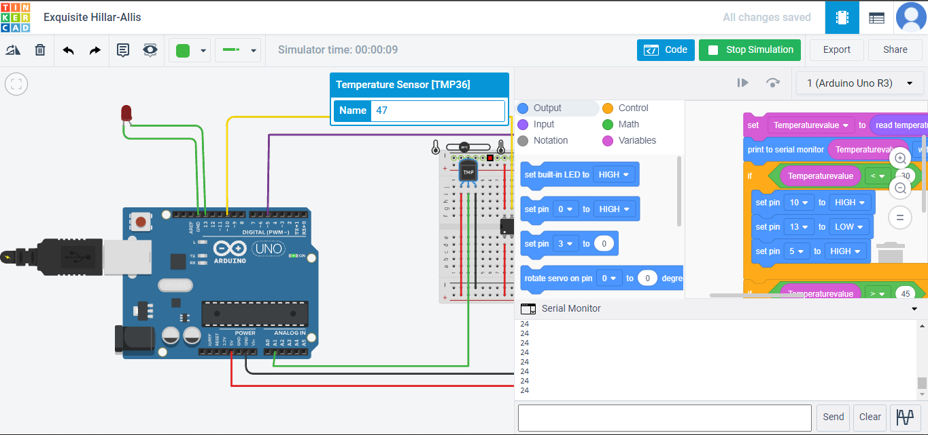
Result Presentation –GA10 (5mks)
The final result on TinkerCad is as follows:
The LED is not glowing and the motor does not run when soil moisture level is 24 as seen in the Serial Monitor:
Build the team and team efforts

Slide 14
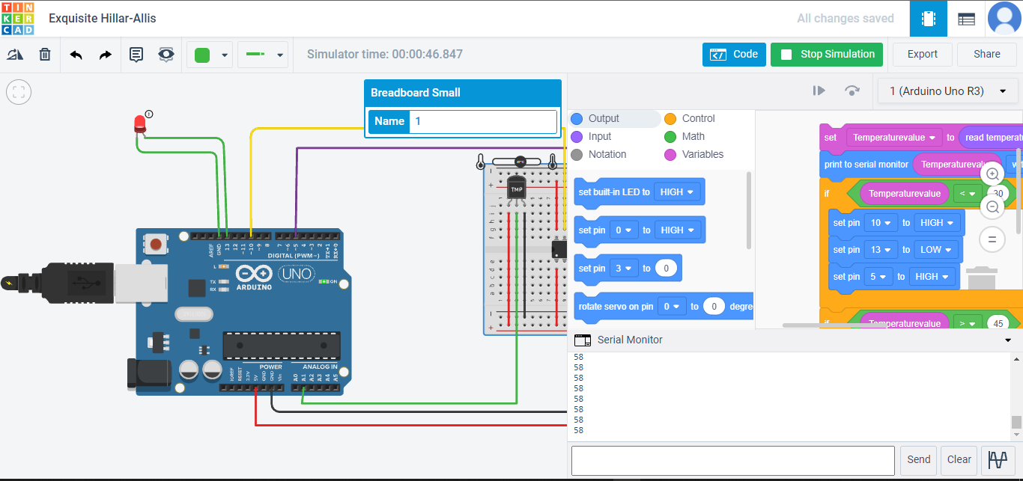
Result Presentation –GA10 (5mks)
The LED is glowing and the motor is working when soil moisture level is 58 as seen in the Serial Monitor:
Build the team and team efforts

Slide 15
Project Link and Github Link
Final Project Link:
https://www.tinkercad.com/things/i69gD8hmEqm-exquisite-hillar-allis/editel?sharecode=iS-e6cShOhf5G0OPAcAIbhswwVEVkRaEsdMeyS5tIMU
Github Repository link:
https://github.com/iisshaa/smartirrigationsystem
Build the team and team efforts

Slide 16
Learning From the Project –GA11 (5mks)
This project starts with a learning about an automated irrigation system. Smart irrigation technology uses soil moisture data to determine the irrigation need of the agricultural field. Smart irrigation system collects information from sensors and sends predefined user orders to actuators, that make the water sprinkler to go off. The data is collected by moisture sensors.
A user defines the moisture and the temperature range.
Further, we have learnt on how to use Tinkercad and its functions.
Additionally, we have also learnt basics about Arduino and the ways it functions

Slide 17
Future Lens: To understand the future opportunities and challenges (Future Scope)-GA12 (5mks)
Irrigation is a process of providing the desire amounts of water to the agricultural land. This process is very beneficial in minimizing runoffs or drought situations for the crop’s cultivation.Due to alarming changes in the climate, farmers cannot rely on natural rainwater.Irrigation is important to yield good quality crops in the seasonable or non-seasonable period.
For modern agriculture, a smart irrigation system is one of the best techniques that give more production in minimum duration. To many extend, this smart irrigation system is designed and fully automated to minimize manual handling in agriculture.And one of the good things is that it is very comfortable for users (or farmers) to understand the concept of IoT and sensors for smart irrigation.It can help you to learn how various sensors can be deployed and utilization of their data to generate events and control irrigation systems.

Slide 18
THANK YOU!
Any questions?

